Slide 1
September 2024 Liaison Forum
This meeting is commencing shortly.
Please ensure your microphone is muted.
Your participation is welcome, please add your questions to the Teams chat as we go or raise your hand after a presentation.
These slides will be published to paymenttimes.gov.au.

Slide 2
Welcome and Overview
Regulator’s Opening Remarks
Reform and Resources Update
Regulatory Operations
Latest Data and Insights
Questions and Discussion
Closing Remarks

Slide 3
Opening Remarks
Robyn Beutel
Payment Times Reporting Regulator

Slide 4
Reforms
Regulator Principles
New Legislation
Payment Times Reporting Amendment Act 2024 and Payment Times Reporting Rules 2024
Amended Regulator Powers
Improving the efficiency of Scheme administration
Reporting Requirements
New reporting entity definition, streamlined and consolidated reporting, and detailed calculation methodologies
Continuous Improvement & Building Trust
We look to deliver our functions with an understanding of issues faced by reporting entities when reporting, and to make compliance as easy as possible.
Being Risk-based & Data Driven
We use data collected under the Act and by other government agencies to reduce regulatory burden by ensuring compliance is targeted efficiently.
Collaboration & Engagement
We understand the complexity and effort needed to meet obligations under the Act will vary for different reporting entities. We welcome feedback from reporting entities and other users of the register to help us improve the delivery of our functions.

Slide 5
Reform and Resources Update
Owen Rayner
Director, Government Response and Reform

Slide 6
New Payment Times Scheme
Payment Times Reporting Amendment Act
Jul 2024
Payment Times Reporting Rules
Sep 2024
Statutory Review
June 2023
Government Response
Dec 2023
What’s happened?
Guidance Consultation
Oct 2024
Guidance Published
Nov 2024
Education & Engagement
H1 2025
New Reports Due
Jun 2025
What’s next?

Slide 7
New Payment Times Scheme
What are the changes?
What do I need to know?
One report (generally)
Fewer reporting fields
Only report on trade credit arrangements
Removal of signed declaration
Reduced reporting for external administration and nil procurement
Streamlined exit from reporting
Changes are a major overhaul
New reporting entity definition
AASB consolidation for reporting
Revised reporting data
Detailed calculation methodology
New incentives – fast and slow payers
Transitional arrangements

Slide 8
New Payment Times Scheme
Automatic extension
Jul 2024
New reporting commences
Dec 2024
End of first reporting period
Jun 2025
First reports due
Oct 2025
Apr 2026
Slow & fast payers identifiable
Slow payer directions
Jul-Dec 2024 | Jan-Jun 2025 | Jul-Dec 2025
Reporting Cycles
Mix old and new reports
New reports only

Slide 9
New Payment Times Scheme
Information Sheets
INFO 9
Transition to the new Scheme
INFO 10
Reforms to payment times reporting
Guidance Notes
Consultation
Virtual sessions & submissions
Publication
November 2024
Communications & Engagement
Education & Engagement
Information sessions, liaison forums
Regulator Website
News article, FAQs

Slide 10
Reform FAQs
Who must report? | Large businesses with consolidated revenue over $100 million. Generally, only one entity in a large corporate group will be a reporting entity.*
I’m no longer a reporting entity (member entity). What do I need to do? | Confirm you are not a reporting entity in the Portal. The amendment Act automatically exited all entities that do not meet the new criteria.
How do I treat foreign entity revenue and transactions? | All revenue from controlled entities is used to determine whether an entity meets the $100 million threshold. Payments by foreign entities to Australian small business suppliers are only reportable if an ABN is recorded.
How are investment companies treated (AASB 10)? | As they are under accounting standards. Updated guidance materials will have more detail
What are the new reporting measures for (average, median, 80% and 95% payment time)? | This data will allow for richer analysis of payment times and practices. Regulator can compare data points to gain insight into the volatility and spread of conduct in a group. 95% used for fast and slow small business payer.

Slide 11
Reform FAQs
What transactions are reportable? | Trade credit arrangements to a supplier of goods or services where an ABN is recorded. Credit card payments that are under $100 or subject to relevant policy can be excluded.
How do the new Rules treat contract terms? | Overriding contract terms are used for reporting. If there are no contract terms, the terms on an invoice are used to report.
Do I need to prepare multiple datasets? | No. Updates to the exposure draft Rules removed the need for multiple datasets. Only a trade credit dataset needs to be prepared. A ‘dataset’ can be evidenced by coding or formulas that are applied to databases. Entities will not need to store an isolated ‘dataset’.
Is any electronic invoicing eInvoicing? | No. Only systems connected to the Peppol eInvoicing network.

Slide 12
Reform FAQs
When will we start to see fast and slow payers on the Register | ‘Slow payers’ and ‘fast payers’ identifiable from Q4 2025. ‘Slow payer’ directions from Q2 2026. Before then, the new dashboard will be improved to identify outliers and entities with good and poor payment practices.
What happens if I pay slow (or late)? | If in slowest 20% for 2 periods can be given a direction to make statements on website, procurement and other documents. May be identified in research and publications by the Regulator, including being identified on new Register dashboards.
How do we get recognised as a good payer? | Fast payers must pay 95% of small business payments in 20 days or less for 12 months. Other practices can also be recognised – reach out and tell us your story.
What type of research is the Regulator going to do? | Broad remit; may include late payment, working capital funding, supply chain finance arrangements.

Slide 13
Regulatory Operations
Peter Chia
Director, Operations

Slide 14
Transition Information
Reporting Periods Commencing Before 1 July 2024
Reporting Periods Commencing
1 July 2024 or Later
Reports need to be lodged under the old reporting requirements.
The definition of a ‘reporting entity’ has changed –> consolidated revenue.
Reporting entities who do not meet the new definition are automatically exited from the Scheme.
New reporting requirements apply.
Information sheets on the reforms and transition are available on the website.

Slide 15
Reports and Enquiries
In the future, reports will automatically be published to the register.
Entities must ensure the report is accurate.
Reports should not contain confidential information or information that could identify suppliers or third parties.
March and September are peak reporting periods.
We encourage entities to lodge reports and extension of time applications early.
Enquiries can be emailed to support@paymenttimes.gov.au

Slide 16
Applications
Note:
Applications must include all necessary documentation, including evidence.
Entities may only apply for an extension of time before the report due date.
Two Extension of Time Application Types
New Application: ‘Volunteering Entity’
New Notice: ‘Ceased to be a Reporting Entity’

Slide 17
Compliance & Enforcement
Focus on entities not registered to report or have registered but failed to report.
The Regulator continues to monitor and enforce compliance with the Act
The Regulator takes an escalating approach to compliance.

Slide 18
Data and Insights
Dean Curley
Director, Systems and Digital Support

Slide 19
July 2024 Regulator’s Update
Average Payment Terms
35 Days
Payments Within 30 Days
69.2%
73% of reporting entities make payments to small businesses.
On average, 30% of total procurement value is with small business.
Industry with Shortest Average Payment Terms
27 days
Public Administration and Safety
Industry with Highest Proportion of Payments Within 30 Days
84%
Education and Training
Industry with Highest Average Proportion of Small Business Procurement (By Value)
44%
Agriculture, Forestry and Fishing
Industry with Lowest Average Proportion of Small Business Procurement (By Value)
23%
Mining
Industry with Longest Average Payment Terms
44 days
Manufacturing
Industry with Lowest Proportion of Payments Within 30 Days
53%
Manufacturing
Since January 2021:
61,555 reports have been lodged
63 entities have elected to be volunteering entities
Of the 11,702 reporting entities that registered:
3,540 (30%) reported individually
8,162 (70%) reported within a group

Slide 20
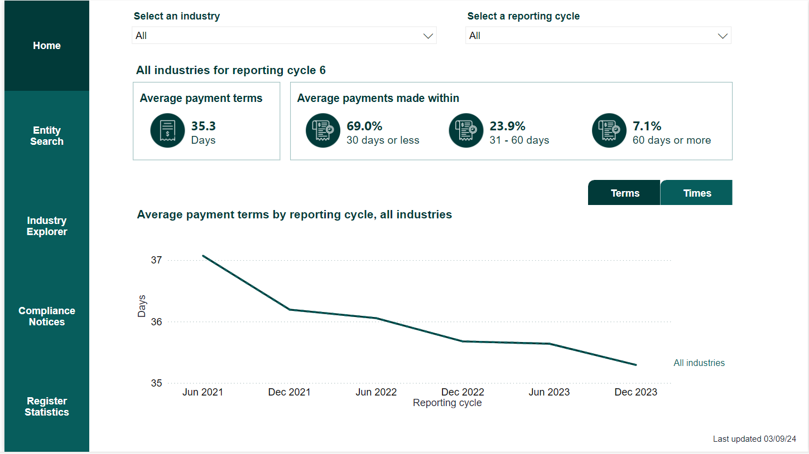
Register
The updated Register Dashboard launched 13 September 2024

Slide 21
Questions?

Slide 22
Closing Remarks
Robyn Beutel
Payment Times Reporting Regulator

Slide 23
Thank You
Next forum: February 2025
support@paymenttimes.gov.au

