Slide 1
February Liaison Forum
This meeting is commencing shortly
Please ensure your microphone is muted
Please turn your video on, it is great to see your face
Your participation is welcome, please add your questions to the Teams chat as we go or raise your hand after a presentation.
These slides will be published to paymenttimes.gov.au

Slide 2
Welcome and overview
Regulator’s opening remarks
Latest insights and data
Policy and resources update
Operations
Questions and discussion
Closing remarks

Slide 3
The Regulator
Mary Jeffries
Payment Times Reporting Regulator

Slide 4
Data and insights
Leanne Kennedy
Director IT, Communications and Data

Slide 5
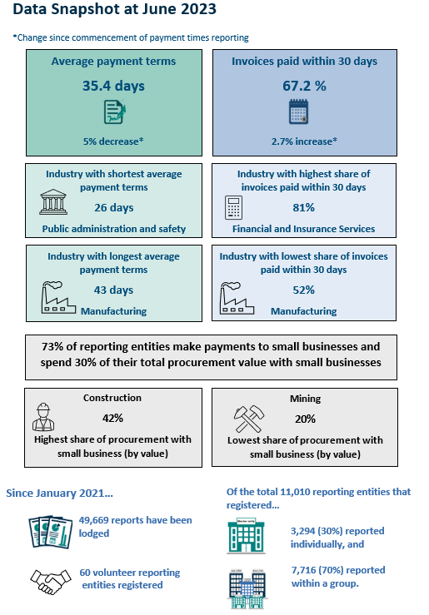
Latest Insights and Data from the January Regulator’s Update
Adds Reporting Cycle 5 data to the analysis
New Data Snapshot feature

Slide 6
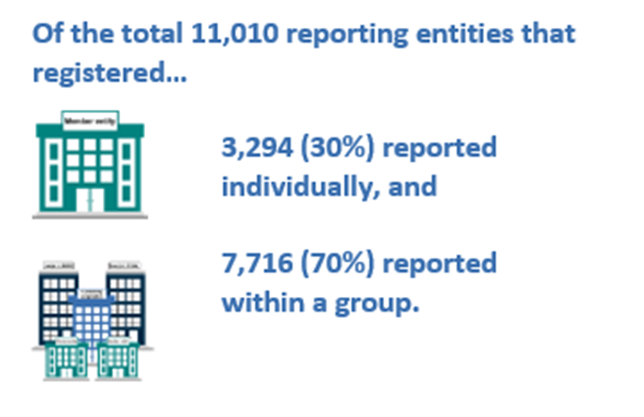
Activity Update

Slide 7
Payment terms
In reporting cycle 5, the average payment term is
35.4 days
This is a
5 per cent fall
in the average term since reporting cycle 1

Slide 8
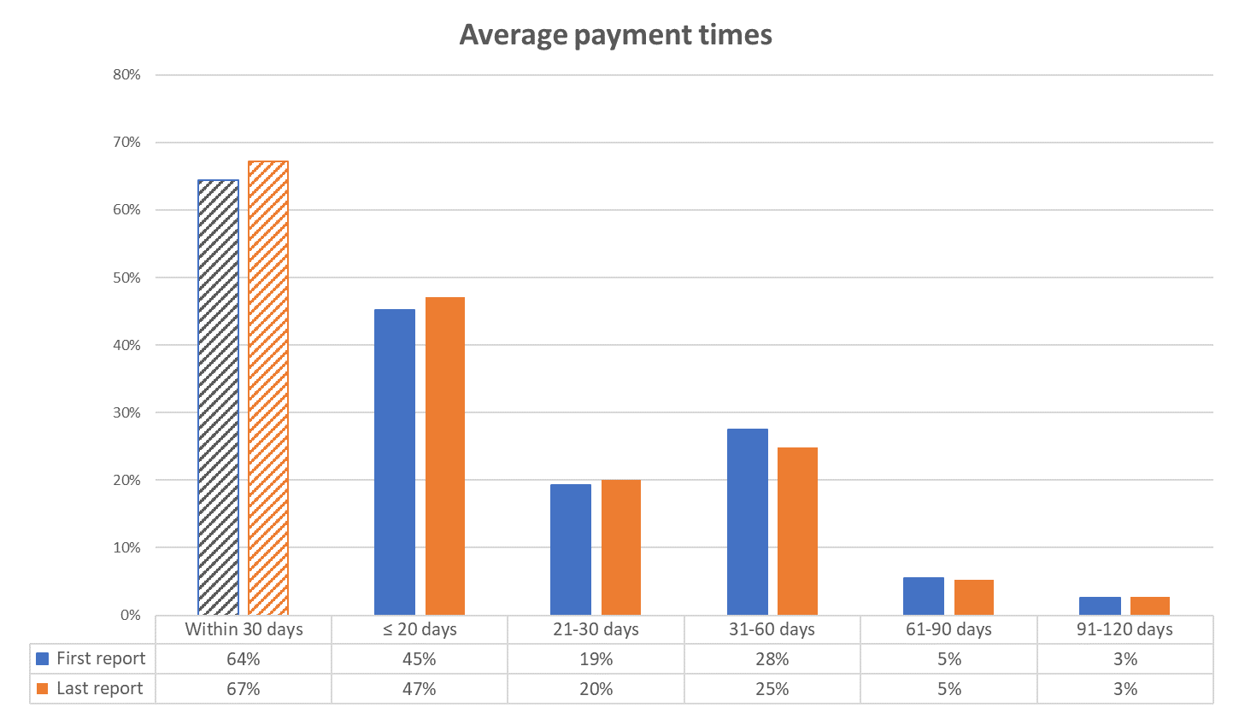
Payment times
By end cycle 5
67%
of small business invoices are being paid within 30 days.
This represents a
3 percentage point improvement
since entities made their first report.

Slide 9
Policy and resources update
Tim Woltmann
Director, Payment Times Policy

Slide 10
Policy Update
Government’s response to the statutory review released in December 2023
Current priority is the implementation of the response
Timing for implementation of legislative reforms is a matter for Government
The Regulator will use communication channels for updates at key junctures
A new Regulator’s Research & Outreach function has commenced
The Regulator will consult extensively on updates to guidance material

Slide 11
Resource Update
Early implementation of Government response to the statutory review
Release of Information Sheet 8: Reporting credit card transactions and updates to the Guidance Notes
Reduce the burden of reporting credit card transactions
Option to exclude all transactions or exclude some payments on value
Update to Information Sheet 6: Small Business Identification (SBI) Tool
Refined guidance for updating the SBI Tool
Commitment to actioning updates to the SBI Tool

Slide 12
Operations
Roman Maevsky
Director, Operations

Slide 13
Reports and Enquiries
Lodge requests to link registered entities for group reporting by 20 March
We are still seeing reporting errors in the 'Business Name' and 'Total Value of Small Business Procurement' fields
We encourage entities to lodge reports early
Remember to use Guidance Note 2: Appendix 1 when preparing reports
The average timeframe for responding to enquiries has reduced

Slide 14
Applications
When considering making an application please review the Tables in Guidance note 3 about eligibility for applications, including determinations
Ensure applications include all necessary evidence and documentation
The Regulator must not allow an entity further time to give a report if the application is made more than 3 months after the end of the relevant reporting period

Slide 15
Compliance & Enforcement
Regulator continues to monitor and enforce compliance with the Act
Focus on late payment times reports
Publication of non-compliance on the Register

Slide 16
Questions

Slide 17
Closing remarks
Mary Jeffries
Payment Times Reporting Regulator

Slide 18
Liaison Forum
Next forum: August 2024
support@paymenttimes.gov.au

