Slide 1
September Liaison Forum
Regulator’s Update | July 2023
This event will commence shortly
Please ensure your microphone is muted
Please turn your video on, it is great to see your face
There will be time for Q&A at the end of each section, please raise your hand or add your question to the chat
These slides will be published to paymenttimes.gov.au

Slide 2
Welcome
Mercia Smith
Assistant Director Data, IT and Communications

Slide 3
The Regulator
Mary Jeffries
Payment Times Reporting Regulator
Assistant Secretary, Payment Performance Branch

Slide 4
Statutory Review of the Payment Times Reporting Act 2020
Review led by the Hon. Dr Craig Emerson
Statutory Review report released Thursday 31 August 2023
What’s next?
Reporting obligations remain

Slide 5
Data and insights
Chloe Richardson
Director Data, IT and Communications

Slide 6
Reports and entities
10,000+ entities - submitted one report
7,638 entities - submitted four reports
Difference due to:
reporting entities entering and exiting the scheme
previously reported and since stopped reporting
reporting after the due date
Figures based on reports as at 30 June 2023

Slide 7
Payment terms
Median remains 30 days
Reporting entities reporting for 4 cycles, since first report:
Analysis:
13% shorter payment terms
5% longer payment terms
82% same payment terms.

Slide 8
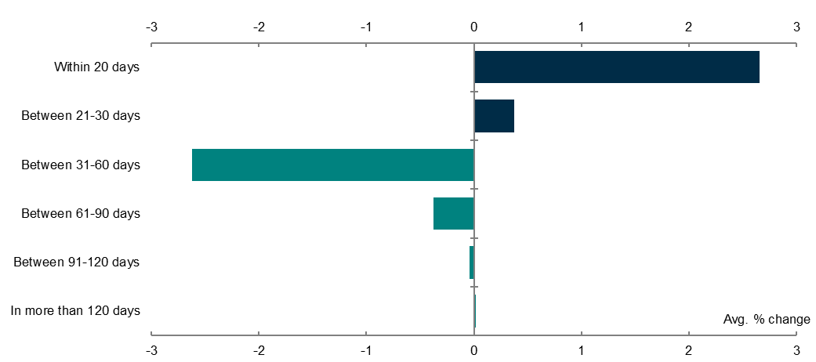
Payment times

Slide 9
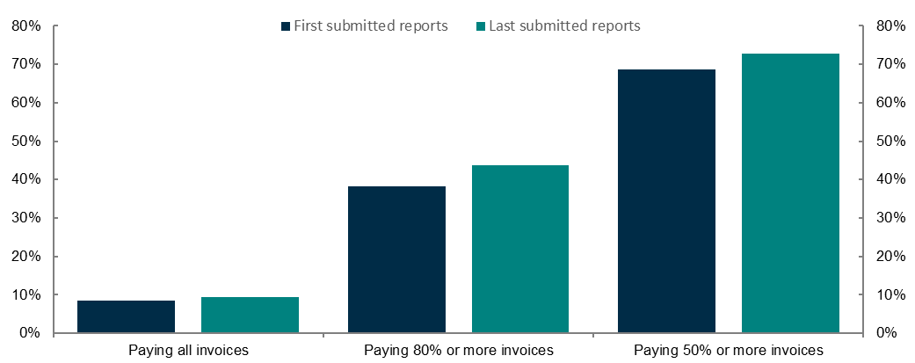
Payment times - 30 day median payment term

Slide 10
Policy and resources update
Carlie Beach
Director, Policy

Slide 11
Policy and resources update
Statutory Review of the Payment Times Reporting Act 2020
treasury.gov.au/review-payment-times-reporting-act-2020
Regulator's Statement of Intent
Updates to the portal and website
Corporate group structure requests
Regulator communications

Slide 12
Regulatory operations
James Matheson
Director, Operations

Slide 13
Reports
Validation changes leading to fewer reporting errors
Where errors identified, we are reaching out to entities to resolve them
Entities encouraged to use Guidance Note 2: Appendix 1 in preparing reports

Slide 14
Applications
Entities not using guidance set out in Guidance note 3
This results in requests for further information
Entities seeking determinations to cease being a reporting entity when not required to do so

Slide 15
Enquiries
Majority of enquiries received are technical assistance
Entities encouraged to familiarise themselves with guidance material
Process for creating/changing reporting groups streamlined to improve timeliness

Slide 16
Compliance & Enforcement
Compliance Program remains ongoing
Failing to register
Failing to report
Regulator approach to non-compliance

Slide 17
Questions

Slide 18
Closing remarks
Mary Jeffries
Payment Times Reporting Regulator Assistant Secretary, Payment Performance Branch

Slide 19
Liaison Forum
Next forum: March 2024
support@paymenttimes.gov.au

